Slide 1
GenAI Based Email Classification and OCR Tool
By Future Evangelists Team:
Venkata Evani
Srinivasu Choppa
Anil Devarala

Slide 2


Project Overview
Current State: Service teams receive a significant volume of servicing requests through emails. These emails Contain diverse requests, often with attachments and will be ingested into the loan servicing platform and creates service requests for workflow processing.
Incoming service requests (SR) via e-mail require a manual triage, where a Gatekeeper has to manually read and interpret the email content and attachments and identify Request type and subtype and extract key attributes and raise SR.
Future State: This project will automate the content exploration from email and its attachments and classify the email using GenAI models and will provide an output with the content types and required information.

Slide 3
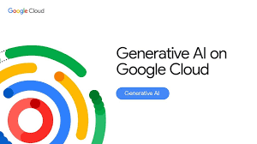

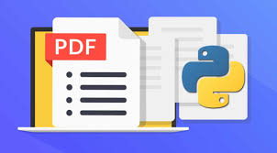
Tech Stack & Tools
Language: Python
Libraries Used:
email, docx, PyPDF2, extract_msg
Google Gemini 1.5 Pro:
Used for natural language understanding & classification
File Types Supported:
Email with/without attachments
PDF, Word, and Text documents

Slide 4
Key Functionalities
✅ Read and parse emails, attachments, or standalone documents
✅ Extract text content from .eml, .pdf, .docx, .txt
✅ Attachment selection & content merging
✅ Gemini API integration for classification
✅ Outputs:
Request Type, Subtype
Sender, Receiver, Date
Amount, Currency
Reasoning

Slide 5
Execution Flow & Next Steps
Flow:
User provides file path
File type is detected and content extracted
Gemini model classifies the request
Output displayed with structured fields
Future Enhancements:
OCR support for scanned/image PDFs
Export results (CSV, DB)
Web or GUI-based interface
Improve classification accuracy via prompt tuning

Slide 6
Summary & Takeaways
✔️ Built a versatile tool for classifying emails and documents using GenAI
✔️ Handles multiple file formats including .eml, .pdf, .docx, and .txt
✔️ Extracts key business fields like Request Type, Sender, Amount, etc.
✔️ Integrated with Google Gemini 1.5 Pro for intelligent classification
✔️ Future-ready with plans for OCR, export, and GUI integration

